Slide 1
Lecture 01 - Practice 01 - Discussion
Prof. André Gustavo Hochuli
gustavo.hochuli@pucpr.br
aghochuli@ppgia.pucpr.br
Notes:
Prof. André Hochuli

Slide 2
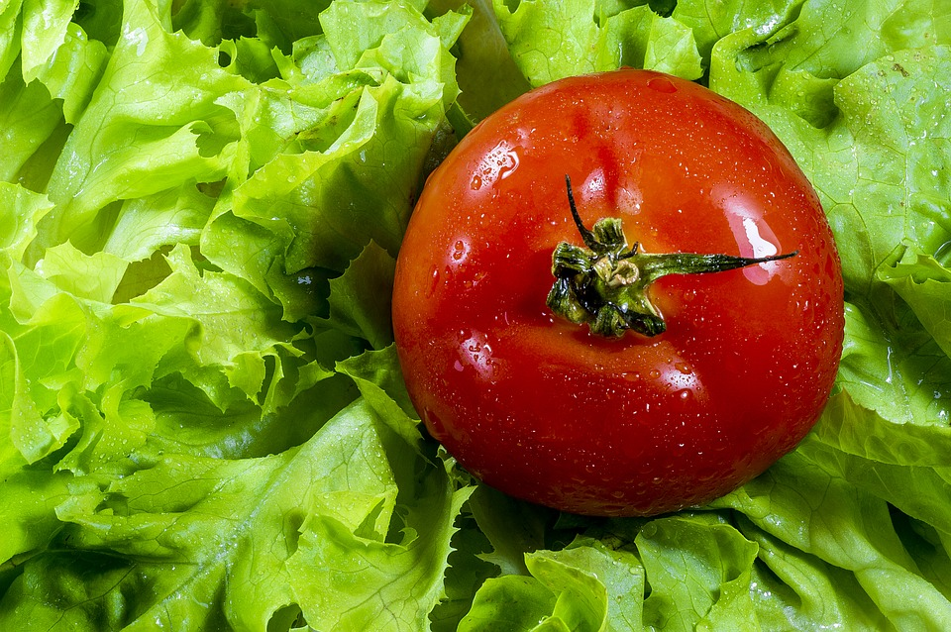
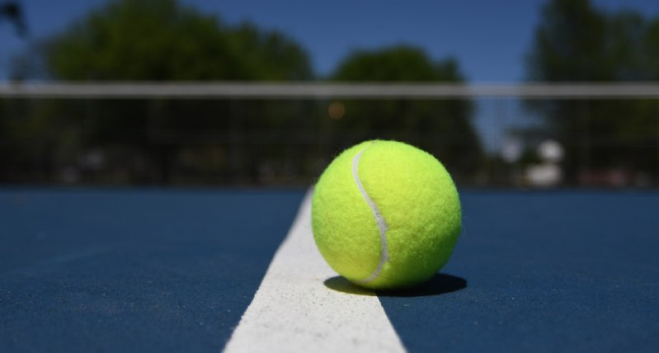
Objective – Color Segmentation
Computer Vision - Prof. André Hochuli
Lecture 01
Notes:
Prof. André Hochuli

Slide 3

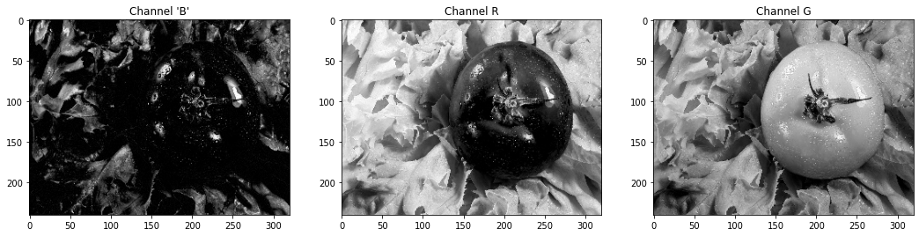
RGB COLORSPACE
One can argue that we can split the red channel to solve the problem.
This rationale is not correct since the color is composed by addition in RGB.
So, the other colors also have a portion of red.
Computer Vision - Prof. André Hochuli
Lecture 01
Notes:
Prof. André Hochuli

Slide 4
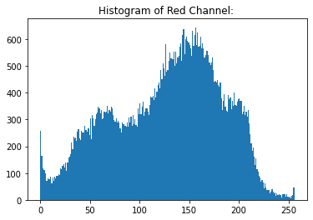
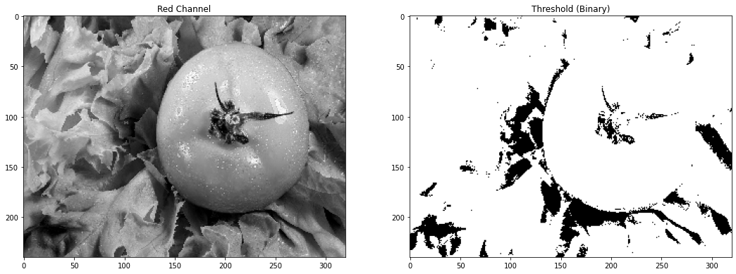
Histogram and Threshold (Red Channel)
The histogram shows how difficult it is to define a threshold.
Computer Vision - Prof. André Hochuli
Lecture 01
Notes:
Prof. André Hochuli

Slide 5
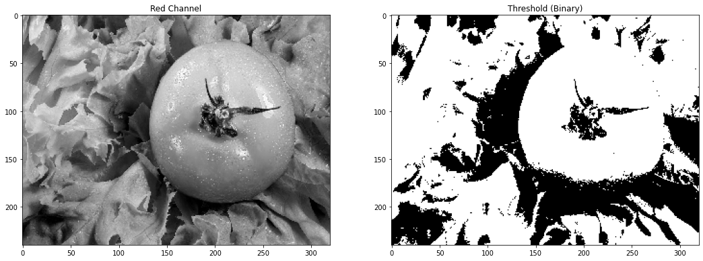
Histogram and Threshold (Red Channel)
The histogram shows how difficult it is to define a threshold.
Computer Vision - Prof. André Hochuli
Lecture 01
Notes:
Prof. André Hochuli

Slide 6
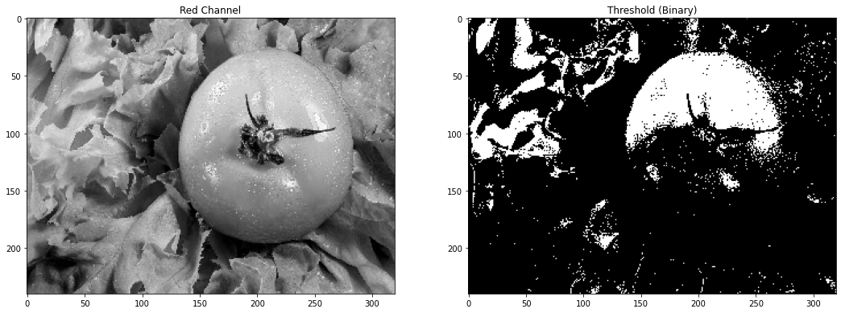
Histogram and Threshold (Red Channel)
The histogram shows how difficult it is to define a threshold.
Let´s code it!
Computer Vision - Prof. André Hochuli
Lecture 01
Notes:
Prof. André Hochuli

Slide 7
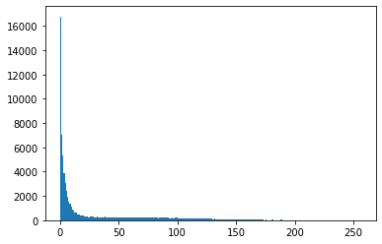
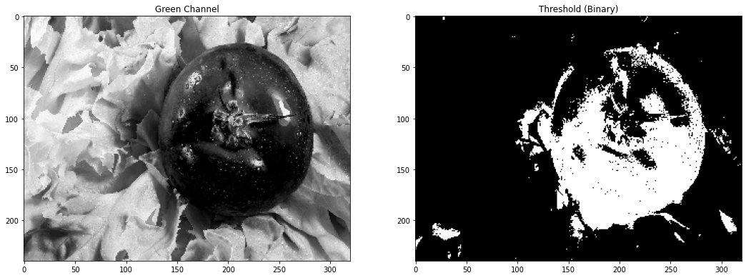
Histogram and Threshold (Green Channel)
The green channel provide a better segmentation, but….
Let´s Code!
Computer Vision - Prof. André Hochuli
Lecture 01
Notes:
Prof. André Hochuli

Slide 8
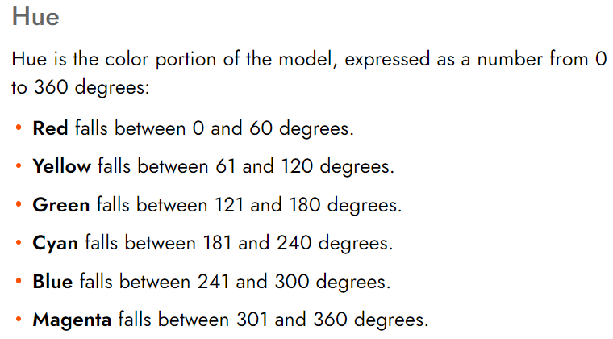
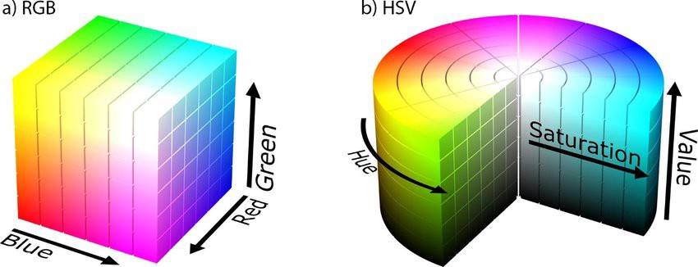
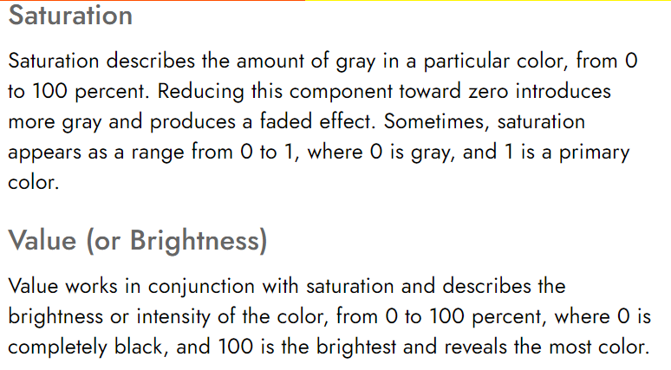
HSV COLORSPACE
HSV (Hue, Saturation, Value)
Computer Vision - Prof. André Hochuli
Lecture 01
Notes:
Prof. André Hochuli

Slide 9
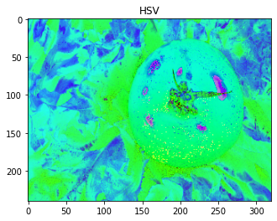
HSV COLORSPACE
RGB -> HSV (Hue, Saturation, Value)
Computer Vision - Prof. André Hochuli
Lecture 01
Notes:
Prof. André Hochuli

Slide 10
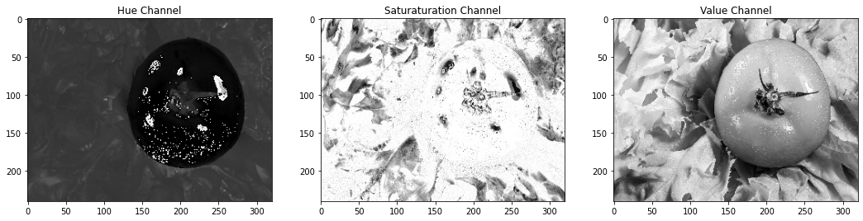
HSV COLORSPACE
RGB -> HSV (Hue, Saturation, Value)
Computer Vision - Prof. André Hochuli
Lecture 01
Notes:
Prof. André Hochuli

Slide 11
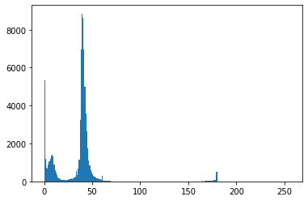
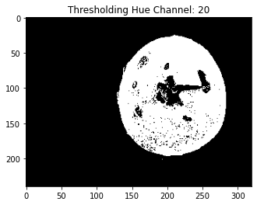
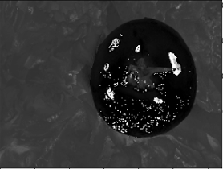
Histogram and Threshold (Hue Channel)
RGB -> HSV (Hue, Saturation, Value)
Computer Vision - Prof. André Hochuli
Lecture 01
Notes:
Prof. André Hochuli

Slide 12
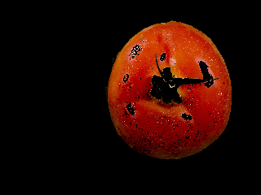
Mask Retrieval (Bitwise_and)
RGB -> HSV (Hue, Saturation, Value)
Let’s Code!
Computer Vision - Prof. André Hochuli
Lecture 01
Notes:
Prof. André Hochuli

